Slide 1
Forensics
Please sign in and grab a sweet treat!
Mrs. Jenny Kravitz
This presentation is
available online!
Notes:
Website and e-mail are KEY

Slide 2
Mrs. Jenny Kravitz
Education
Experience
Tufts University
Bachelor’s – Biology
Teacher Licensure Program
Biotech R&D Internship: Abbott Diabetes Care
All American, Track & Field
UMass Lowell
Master’s – Biology
Master’s Research: Tufts Medical Center, Simon Lab
Professional MA License
Began teaching in 2003
AP, Honors, CP, SpEd/inclusion, ELL/SEI
Biology, Chemistry, Physical Science, Earth Science
Independent contractor teaching AP Bio in Mass
Advising, coaching, mentoring
Educational Grant Work
Developing/publishing curriculum
Obtaining/implementing biotech equipment
Notes:
Education: emphasis on Biology (particularly biotech), also teacher training
Experience: variety of levels/subjects, extensive AP experience, mentoring students & colleagues
Grant collaborations: BU, BC, MIT, MoS, ASHG, College Board

Slide 3
Course Objectives
Provide students with basic knowledge and skills in the area of Criminalistics (Forensic Science)
Develop critical thought and analysis skills
Practice scientific inquiry in laboratory
Equip students with necessary knowledge and skills to collect and evaluate evidence at a crime scene
Midterm/final exam is a simulated crime scene, analyzed in investigative teams (students each have specialized roles)
Notes:
Skills (analytical & inquiry) are just as important as content!

Slide 4
Course Design
Assessment
Instruction
Notebook (40%)
Contains notes, activities, assignments, etc.
Students are creating a manual for crime scene analysis (for final)
Quizzes (30%)
Often open notebook
Application of content and skills (practice for final)
Papers (20%)
Examine conflicts of public safety and individual rights
Further explore topics from class
Case Study/Questions (10%)
Analysis of real cases
Application of concepts
Interactive class discussion
Notes cover evidence collection, processing, and analysis
Emphasis on discussion of science behind methodology and legal/criminal application
Hands-on inquiry activities
Practice forensics skills
Collaborative groups
Real-world application
Current cases (in news)
Forensic Files (famous cases)
Notes:
Focus is on Criminalistics (science of evidence analysis). (Criminal minds – more legal and psychological content)
Instruction is designed to promote cooperative learning communities and real-world application of 21st century skills

Slide 5
Topics of Study
Criminalistics Intro
Legal System
Types of Evidence
Fingerprints
Blood Spatter
DNA Evidence
Human Remains
Document & Handwriting Analysis
Witness Interrogation
Crime Scene Processing
Securing Evidence

Slide 6
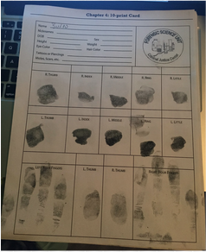
Fingerprints

Slide 7
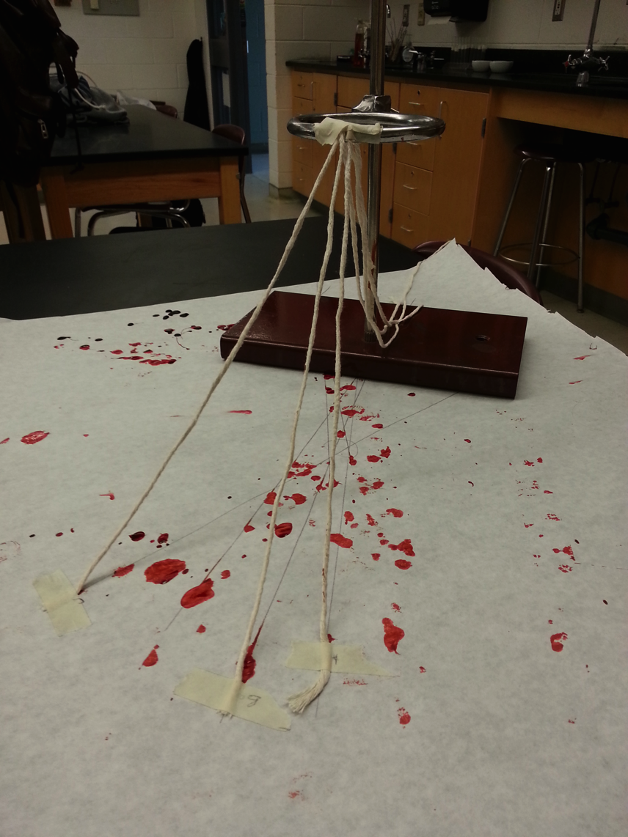
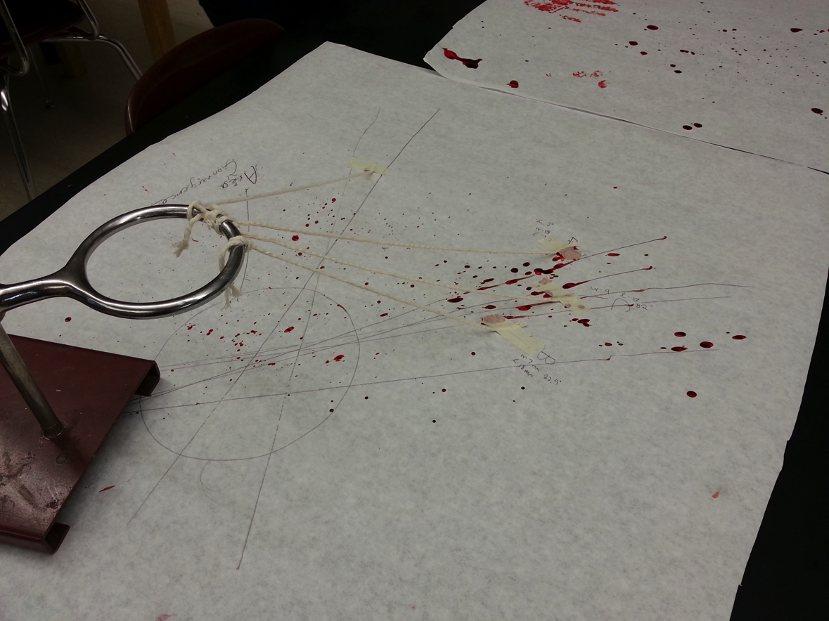
Blood Spatter Triangulation

Slide 8
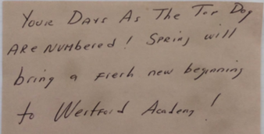
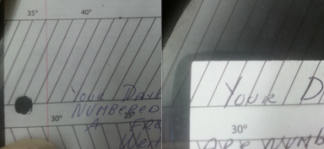
Handwriting Analysis

Slide 9
Involved Law Enforcement
School Resource Officer
Detective Jeff Pavao
Spends time in class sharing expertise
Guest speaker from Westford PD
Detective David O’Hearn
Showcases forensic “tool bag” for processing a crime scene (simulates crime scene in classroom)
Guest speaker from state crime lab
Massachusetts State Trooper Criminalistics and Crime Scene Response Unit
Forensic Scientist & Supervisor Christina Owen

Slide 10
Midterm/Final Exam
Simulated crime scenes
Evidence for collection and analysis
Suspects for interviews and additional evidence
Investigative teams of students
Specialized roles
Collaborate on analysis and presentation
Application of knowledge and skills developed throughout the semester
Culminates in presentation and defense of criminalistics findings and implications for simulated cases (solve the crime)

Slide 11
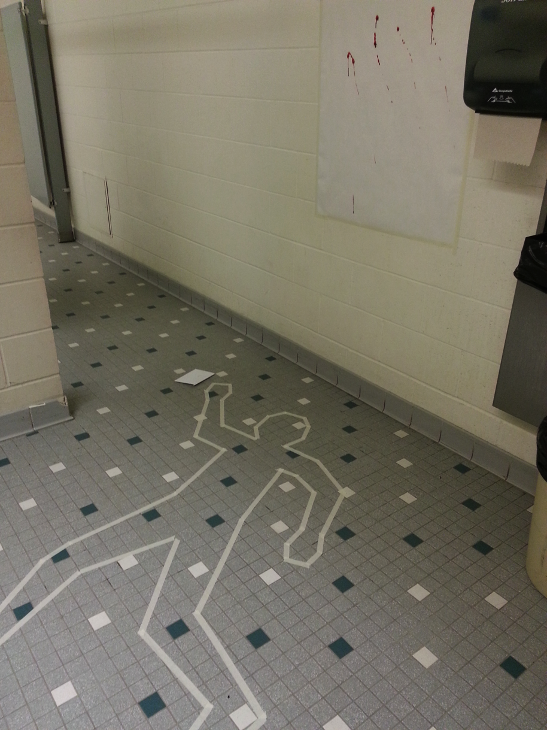
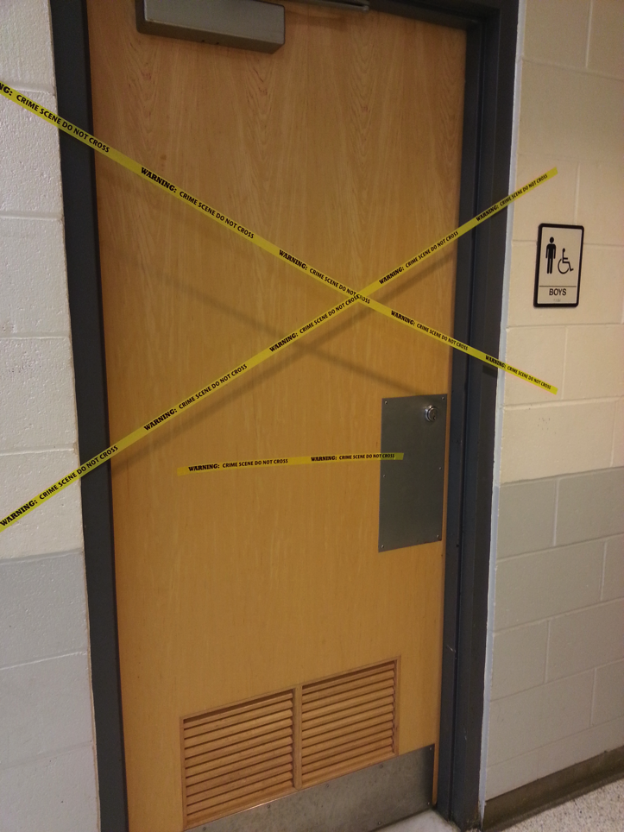
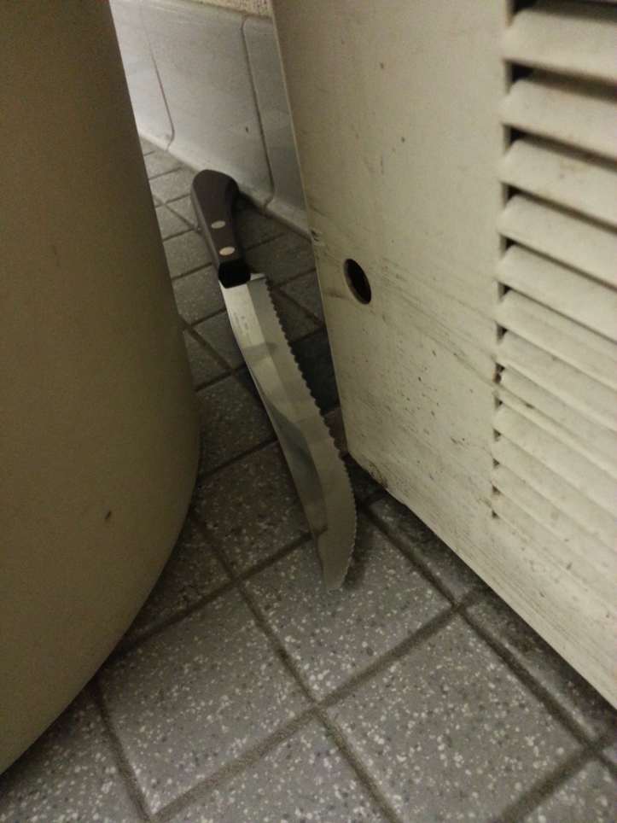
Crime Scene Simulation

