Slide 1
Chapter 1 Introduction to Forensic Science and the Law

Slide 2
Forensic Science
The study and application of science to matters of law.
Includes the business of providing timely, accurate, and thorough information to all levels of decision makers in our criminal justice system.

Slide 3
Criminalistics vs Criminology
Criminalistics
the scientific examination of physical evidence for legal purposes.
Criminology
includes the psychological angle, studying the crime scene for motive, traits, and behavior that will help to interpret the evidence

Slide 4
Crime Lab Services
Physical Science Unit
Chemistry
Physics
Geology
Biology Unit
Firearms Unit
Document Examination Unit
Photography Unit
Toxicology Unit
Latent Fingerprint Unit
Polygraph Unit
Voiceprint Analysis Unit
Evidence Collection Unit

Slide 5
Other Forensic Science Services
Forensic Pathology
Forensic Anthropology
Forensic Entomology
Forensic Psychiatry
Forensic Odontology
Forensic Engineering
Cybertechnology

Slide 6
Major Crime Laboratories
FBI (Federal Bureau of Investigation)
Largest in the world
DEA (Drug Enforcement agency)
Department of Treasury
ATF (Bureau of alcohol, tobacco, an firearms)
U.S. Postal Service
U.S. Fish and Wildlife Service

Slide 7
The “Father of Criminalistics”
Edmond Locard (1877-1966)
French professor
Built the world’s first forensic laboratory in France in 1910
Locard Exchange Principle:
Whenever two objects come into contact with each other, traces of each are exchanged.

Slide 8
Crime Scene Team
A group of professional investigators, each trained in a variety of special disciplines.
Team Members
First Police Officer on the scene
Medics (if necessary)
Investigator(s)
Medical Examiner or Representative (if necessary)
Photographer and/or Field Evidence Technician
Lab Experts
pathologist serologist
DNA expert toxicologist
forensic odontologist forensic anthropologist
forensic psychologist forensic entomologist
firearm examiner bomb and arson expert
document and handwriting experts fingerprint expert

Slide 9
Scientific Method (as it pertains to criminalistics)
Observe a problem or questioned evidence and collect objective data.
Consider a hypothesis or possible solution.
Examine, test, and then analyze the evidence.
Determine the significance of the evidence.
Formulate a theory based on evaluation of the significance of the evidence

Slide 10
The Bill of Rights Gives individuals the right:
To be presumed innocent until proven guilty
Not to be searched unreasonably
Not to be arrested without probable cause
Against unreasonable seizure of personal property
Against self-incrimination
To fair questioning by police
To protection from physical harm throughout the justice process
To an attorney
To trial by jury
To know any charges against oneself
To cross-examine prosecution witnesses
To speak and present witnesses
Not to be tried again for the same crime
Against cruel and unusual punishment
To due process
To a speedy trial
Against excessive bail
Against excessive fines
To be treated the same as others, regardless of race, gender, religious preference, country of origin, and other personal attributes

Slide 11
Facets of Guilt
Try to prove:
Means—person had the ability to do the crime
Motive—person had a reason to do the crime (not necessary to prove in a court of law)
Opportunity—person can be placed at the crime

Slide 12
Prosecution & Criminal Law
Presumption of Innocence
Defendant is innocent until proven guilty
Burden of Proof
Responsibility of prosecution to present evidence to prove guilt of defendant
Beyond a Reasonable Doubt
No other logical explanation can be drawn from the facts except that the defendant committed the crime
Unanimous Jury
In criminal court, the decision of the jury must be unanimous to result in the conviction of the defendant

Slide 13
Chapter 2: Types of Evidence

Slide 14
Types of Evidence
Testimonial—a statement made under oath; also known as direct evidence or Prima Facie evidence
Physical—any object or material that is relevant in a crime; also known as indirect evidence. Examples are hair, fiber, fingerprints, documents, blood, soil, drugs, tool marks, impressions, glass.

Slide 15
Reliability an Eyewitness
Factors:
Nature of the offense and the situation in which the crime is observed
Characteristics of the witness
Manner in which the information is retrieved
Additional factors:
Witness’s prior relationship with the accused
Length of time between the offense and the identification
Any prior identification or failure to identify the defendant
Any prior identification of a person other than the defendant by the eyewitness

Slide 16
How attentive are we?
Brain Games “Switcharoo”
http://natgeotv.com.au/videos/brain-games/switcheroo-A8D68670.aspx

Slide 17
False Memories
Use a scrap piece of paper
I will read a list of words for you to remember (no cheating!)
You will immediately have 60 seconds to write as many as you can remember

Slide 18
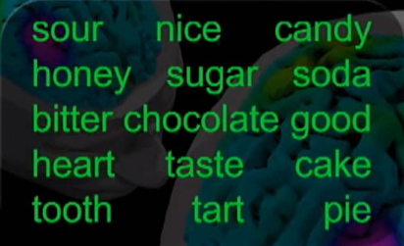

Slide 19
Write as many words as you can remember. You have 60 seconds!

Slide 20
How do you think you did?
How many words do you think you remembered?
Now that you’ve practiced, let’s do it again!

Slide 21
False Memories – Second Chance
Flip over your paper
We’re going to do it again with a new list
Same rules (NO CHEATING!)

Slide 22
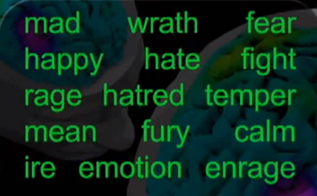

Slide 23
Write as many words as you can remember. You have 60 seconds!

Slide 24
How did you do?
How many people have “sweet” on the first list?
How many people have “anger” or “angry” on the second list?

Slide 25
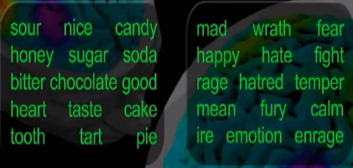
Those words are FALSE MEMORIES!

Slide 26
1956 Airshow Disaster in England
Fighter jet crashed during maneuver
100,000+ witnesses (aviation enthusiasts who were watching the maneuver as part of the show)
Investigators asked for testimony
A few thousand written eyewitness accounts
Less than 6 were consistent with physical evidence that was also collected

Slide 27
Value of Physical Evidence
Generally more reliable than testimonial
Can prove that a crime has been committed
Can corroborate or refute testimony
Can link a suspect with a victim or with a crime scene
Can establish the identity of persons associated with a crime
Can allow reconstruction of events of a crime

Slide 28
Reconstruction
Physical Evidence is used to answer questions about:
what took place
how the victim was killed
number of people involved
sequence of events
A forensic scientist will compare the questioned or unknown sample with a sample of known origin.

Slide 29
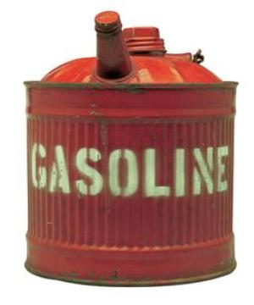
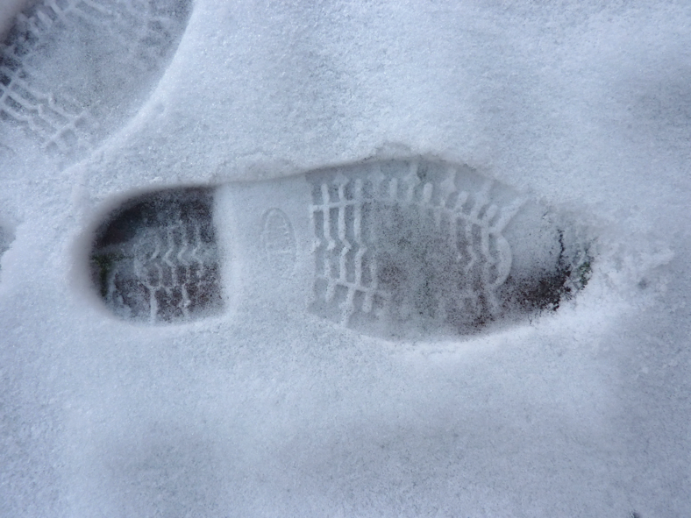
Examples of Transient Evidence
Odor—putrefaction, perfume, gasoline, urine, burning, explosives, cigarette or cigar smoke
Temperature—surroundings, car hood, coffee, water in a bathtub, cadaver
Imprints and indentations—footprints, teeth marks in perishable foods, tire marks on certain surfaces
Markings

Slide 30
Examples of Pattern Evidence
Pattern Evidence—most are in the form of imprints, indentations, striations, markings, fractures or deposits.
Clothing or article distribution
Gun powder residue
Material damage
Body position
Tool marks
Modus operandi
Blood spatter
Glass fracture
Fire burn pattern
Furniture position
Projectile trajectory
Tire marks or skid marks

Slide 31
Examples of Conditional Evidence
Light—headlight, lighting conditions
Smoke—color, direction of travel, density, odor
Fire—color and direction of the flames, speed of spread, temperature and condition of fire
Location—of injuries or wounds, of bloodstains, of the victim’s vehicle, of weapons or cartridge cases, of broken glass
Vehicles—doors locked or unlocked, windows opened or closed, radio off or on (station), odometer mileage
Body—position, types of wounds; rigor, livor and algor mortis
Scene—condition of furniture, doors and windows, any disturbance or signs of a struggle

Slide 32
Evidence Characteristics
Class—common to a group of objects or persons
Individual—can be identified with a particular person or a single source
Fingerprints
Blood DNA Typing

Slide 33
Class vs Individual Evidence
These fibers are class evidence; there is no way to determine if they came from this specific garment.
The large piece of glass fits exactly to the bottle; it is individual evidence.

Slide 34
Direct vs. Circumstantial Evidence
Direct Evidence
Supports the truth of an assertion directly, without need for any additional evidence or inference
Example: Fingerprints on murder weapon
Circumstantial Evidence
Relies on an inference to connect it to a conclusion of fact (allows for more than one explanation, but typically used in corroboration to support a conclusion)
Example: Handwriting on threatening note

